Slide 1
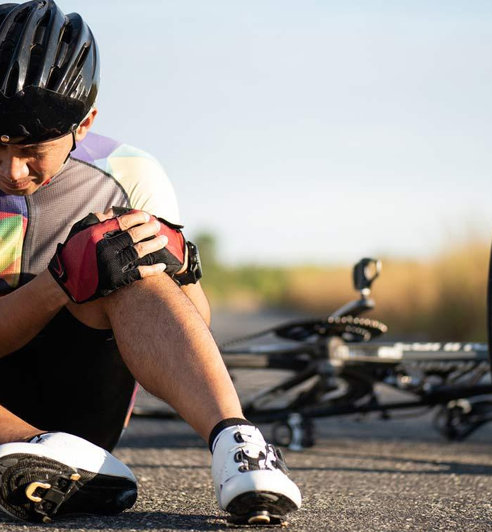

Bike & Motor Crash Analysis Proposal to North Carolina Road Control
Umar Aziz, Shengjie Jin, Ghousiya Shaikh, Pawan Kumar Vadlamani

Slide 2
Overview
Objective is to clean, transform, analyze bike crash data in the state of North Carolina state and generate patterns to visualize frequency of Serious & Fatal accidents. We plan to utilize supervised Machine Learning techniques to identify the root causes of these accidents and develop strategies for prevention.
Goal of project : To determine what causes the crashes, level of fatalty to help the road safety departments improvise safety measures and policies pertaining to reduce the occurrence of crashes.
DataSet Source: The dataset is collected from Kaggle website. The link for the data is
https://www.kaggle.com/datasets/atharvaingle/bikepedcrash
Our dataset holds all of the information related to bike crash include the bike rider's information the driver's information and the other objective conditions such as weather and road conditions etc, which will allow us to understand the attributions that lead to the bike crash and correlated circumstances.

Slide 3
Research Areas
Benefits of the Project
Problems to be Solved
Machine Learning Algorithms to predict Fatality
Limitations to the Data Set and Suggestions to overcome the same

Slide 4



Potential Benefits of the project
Primary - Department of transportation for the state of Carolina
Provide safer road, educate public drivers and riders, prevent fatality, reduce severity of crashes)
Secondary - Insurance companies
Visibility of high prone crash area, decide the premiums accordingly

Slide 5

Problems to be Solved
Crashes Over The time period
Attributes Contributing to Fatality
Our Business Intelligence recommendations
Limitations to the Data Set

Slide 6
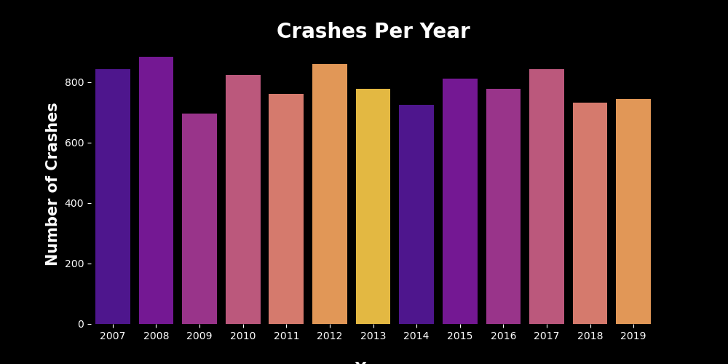
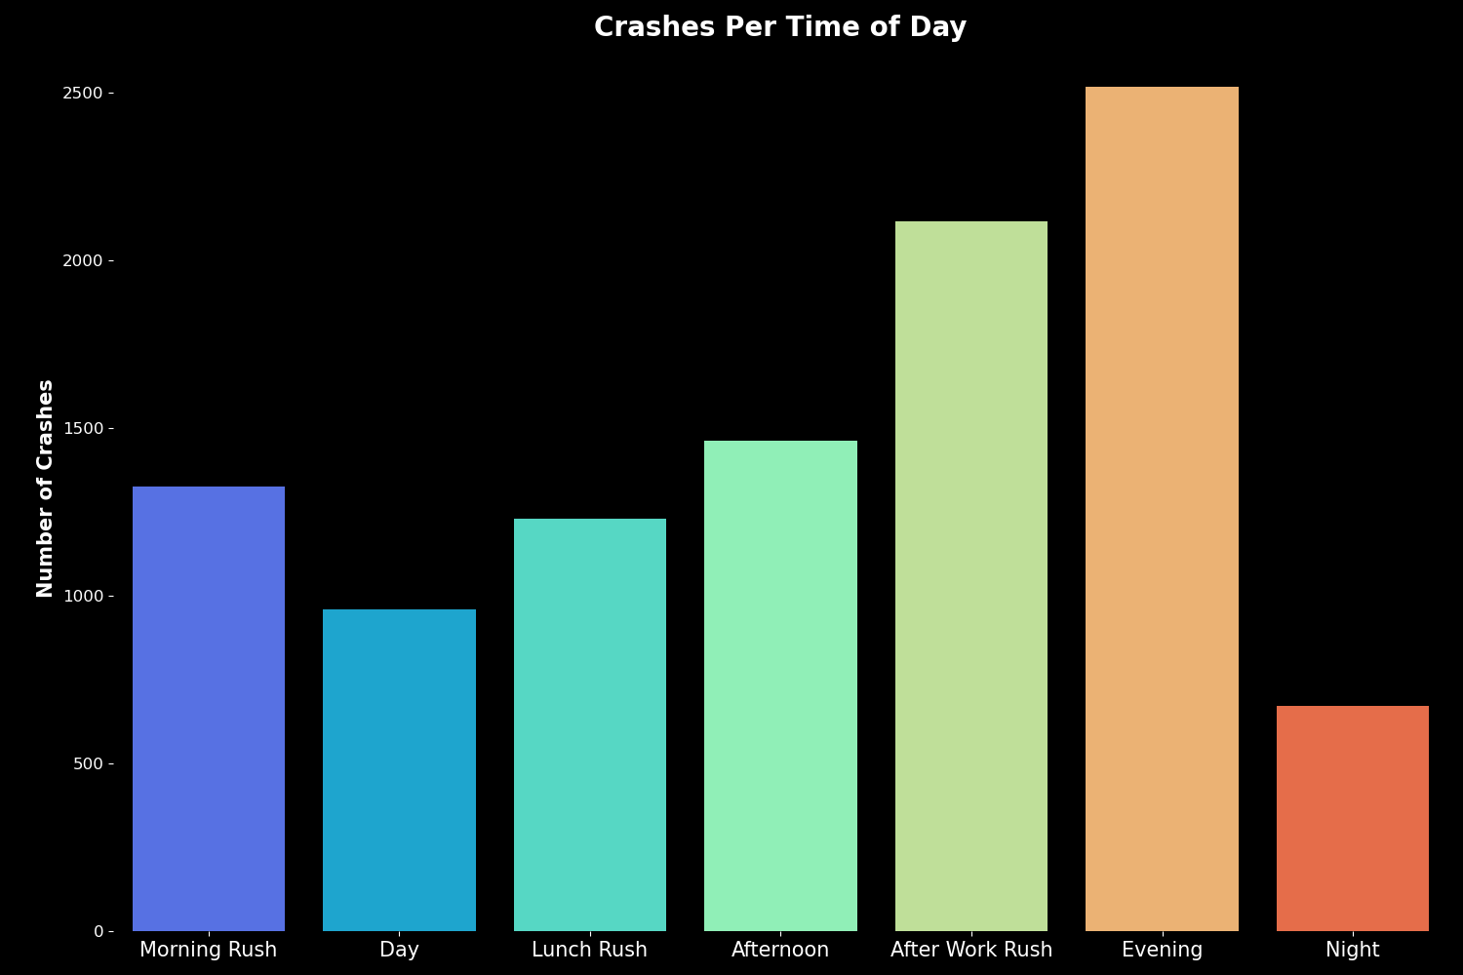
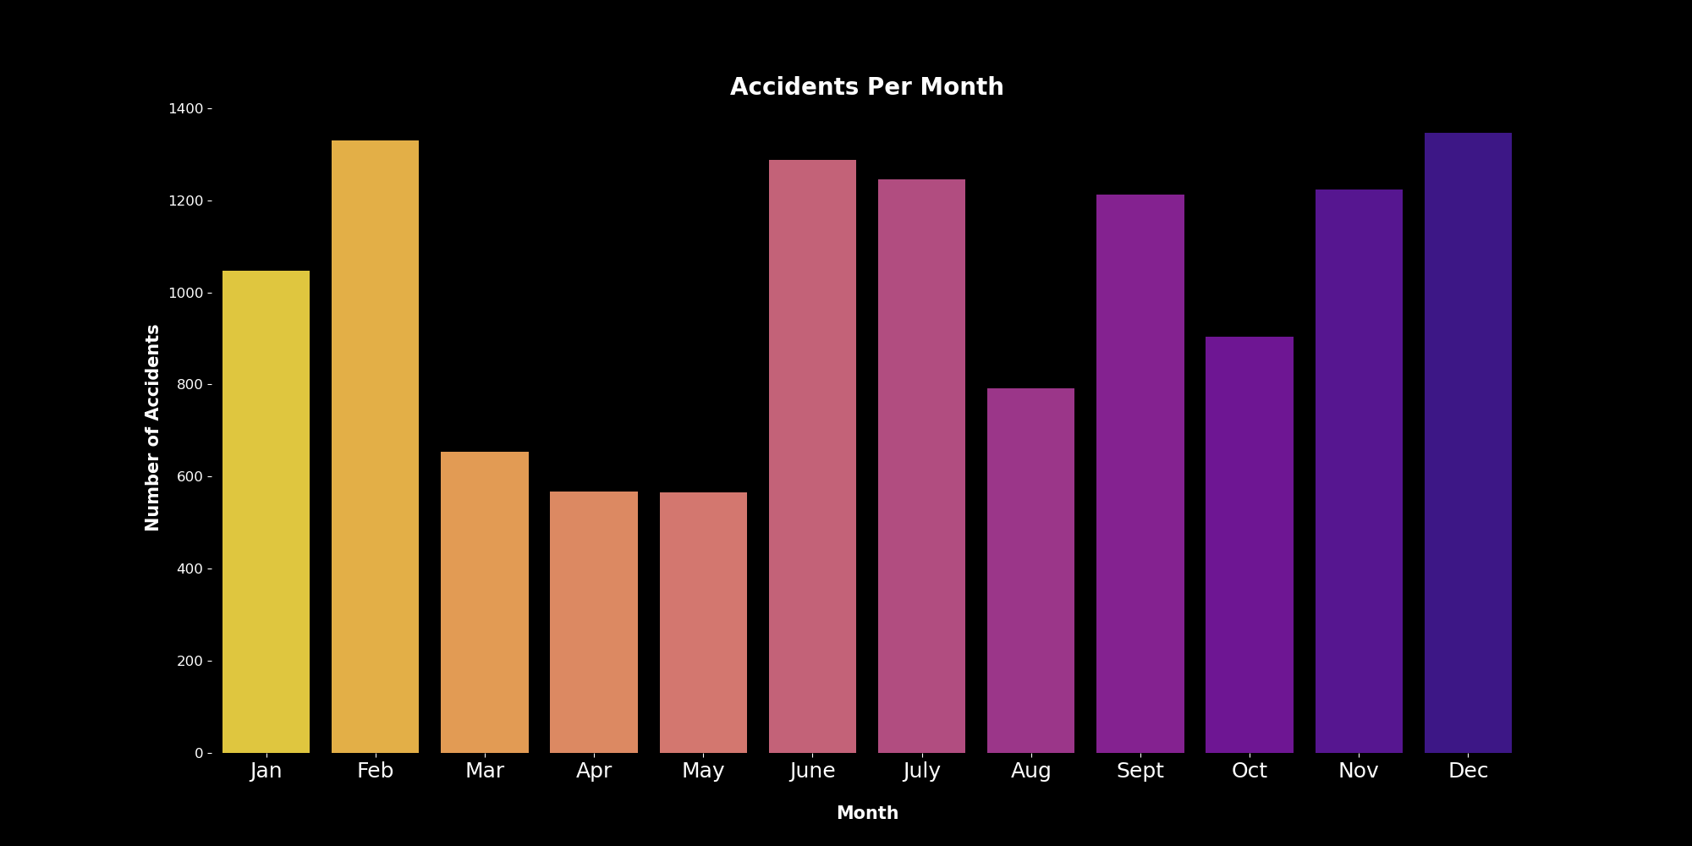
Visualization of Crashes over period (Day, Month, Year)
From the visualizations it can be interpreted that the evening and after work hours are more prone to occurrence of crash
The distribution of crash over the subsequent years from 2007 to 2019 doesn’t imply any potential decline in the accident occurrence
Notes:
From the visualizations it can be interpreted that the evening and after work hours are more prone to occurrence of crash
The distribution of crash over the subsequent years from 2007 to 2019 doesn’t imply any potential decline in the accident occurrence

Slide 7
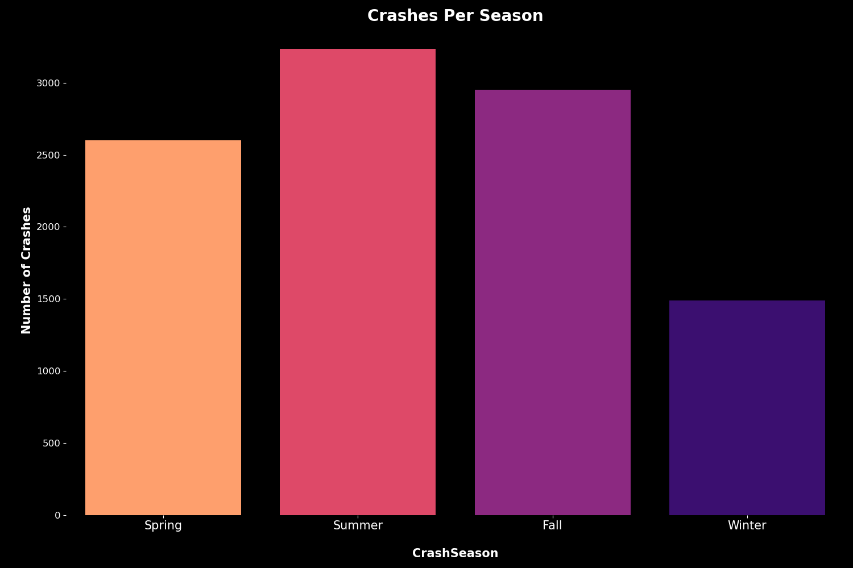
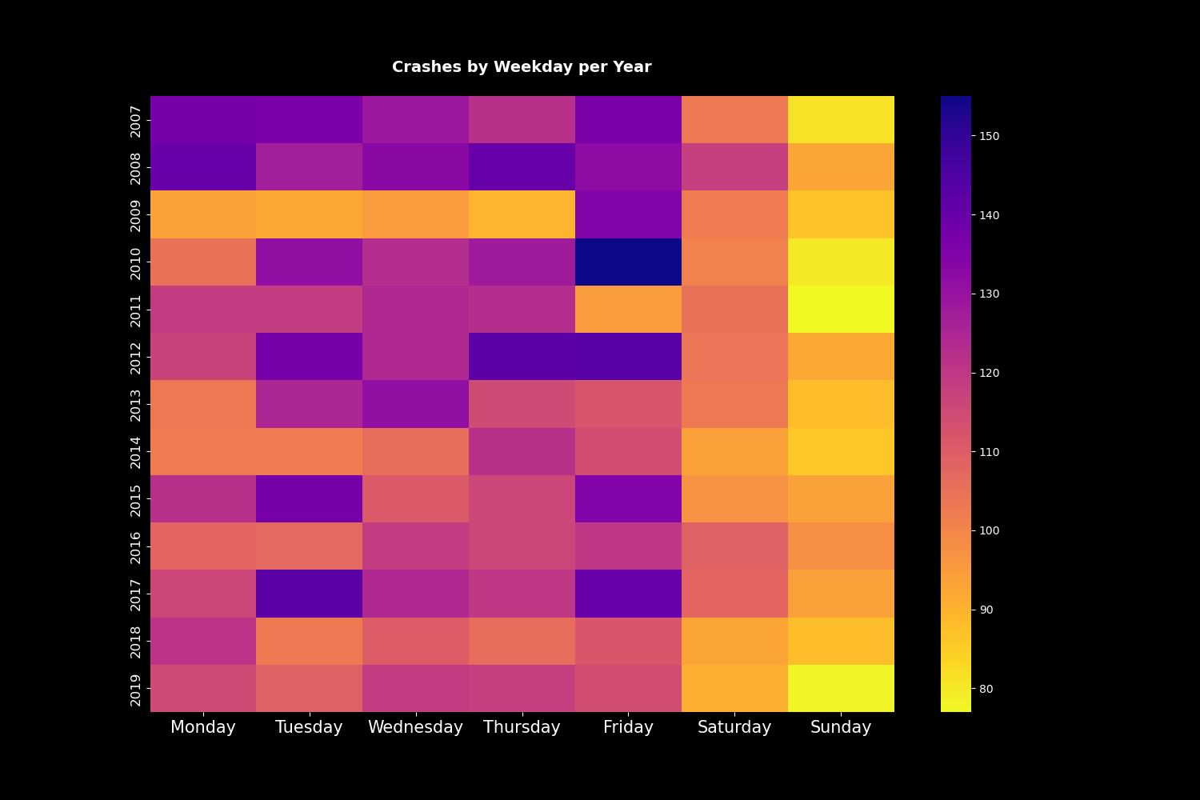
Summer & Fall have the highest number of crashes. The authorities need to further analyze the reasons for the same.
Fridays are the day of the week where the most accidents occur in most of the years. More information required to explain this occurrence.

Slide 8
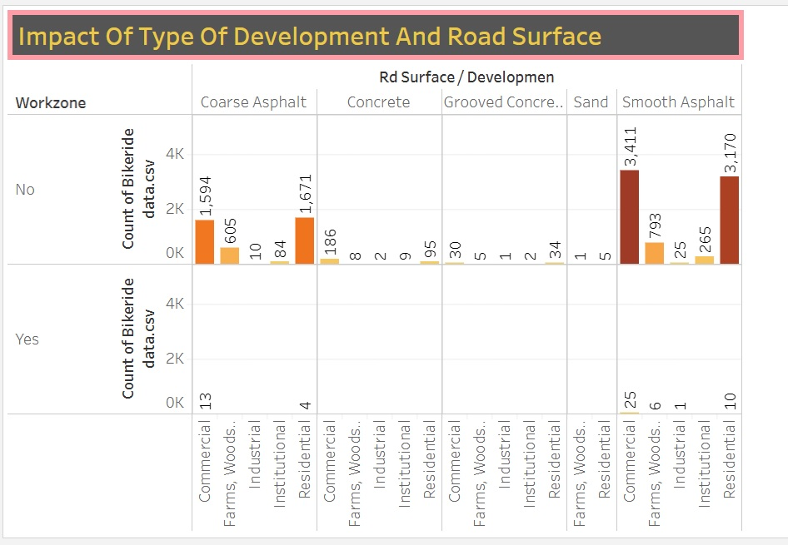
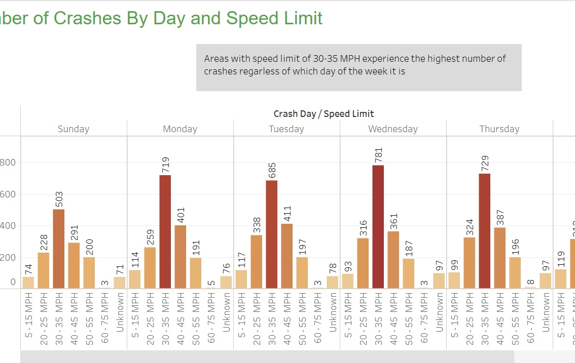
Regardless of which day of the week it is, the areas where speed limit is between 30-35 MPH experience the highest number of crashes.
Almost all the accidents took place in non-work zones - in either commercial or residential areas, majority of which were on Smooth Asphalt

Slide 9
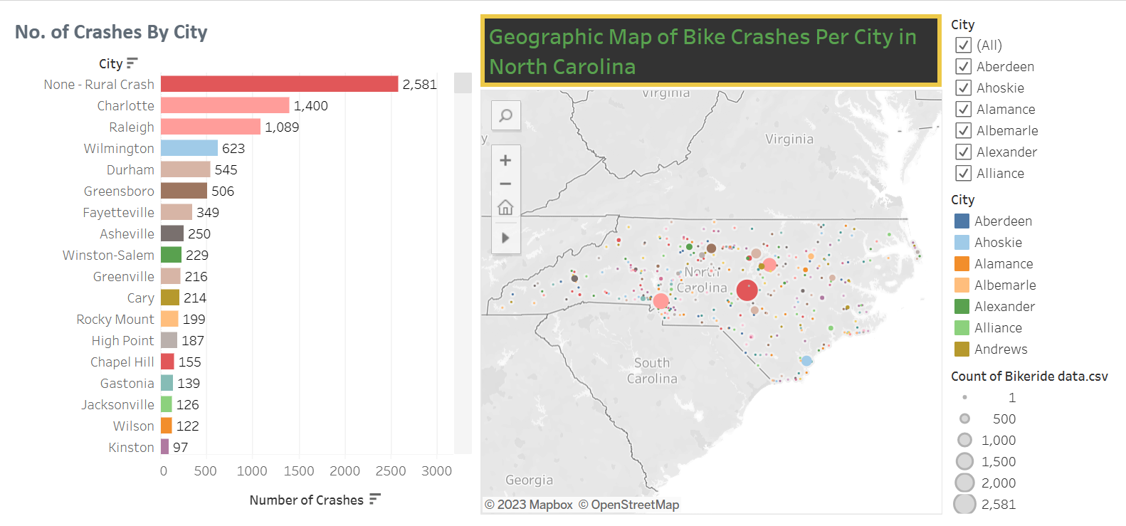
Crashes Per City
Rural Area account for the maximum number of crashes.
City of Charlotte experienced the highest number of bike crashes, followed by the city of Raleigh

Slide 10
Contribution of Factors to fatality
BikeInjury
RuralUrban
TraffCntrl
These features were found to have the highest relation to Crash Fatality.
We will discuss few of the factors in the subsequent slides using visualizations.
For better visuals, we had created two separate data frames.
Locality
LightCond
DrvrInjury
DrvrAlcFlg
CrashAlcoh
RdClass
BikeAlcFlg
AmbulanceR
SpeedLimit

Slide 11
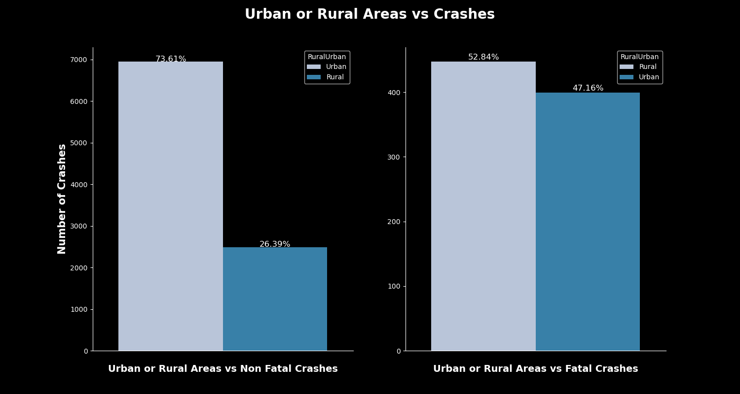
Urban or Rural Areas
Rural areas had a higher percentage of Fatal crashes. This might have been due to
Unavailability of hospitals or Ambulance at the site. This information is not available.

Slide 12
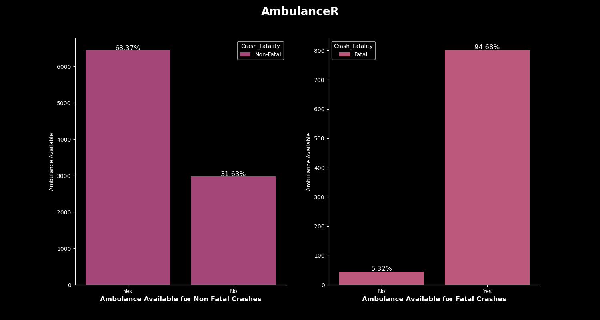
Availability of Ambulance
Ambulances were available for 95% of the fatal crashes.
In Non-Fatal cases, Ambulance were available in 70% of the cases.
We are not aware of whether they reached on time and people received the required first aid or treatment on time.

Slide 13
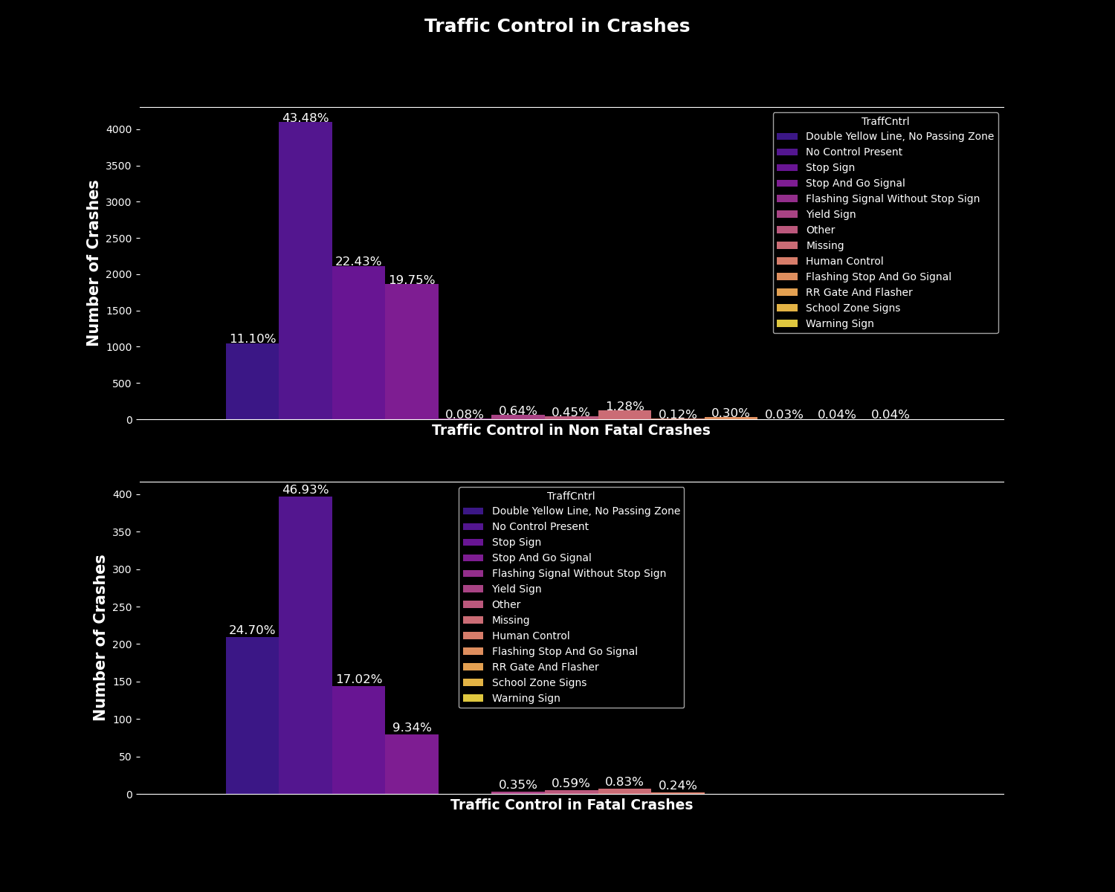
Traffic Control In Crashes
Absence of Traffic Control is the biggest reason of crashes ( Fatal & Non-Fatal)
This needs to be implemented on priority

Slide 14
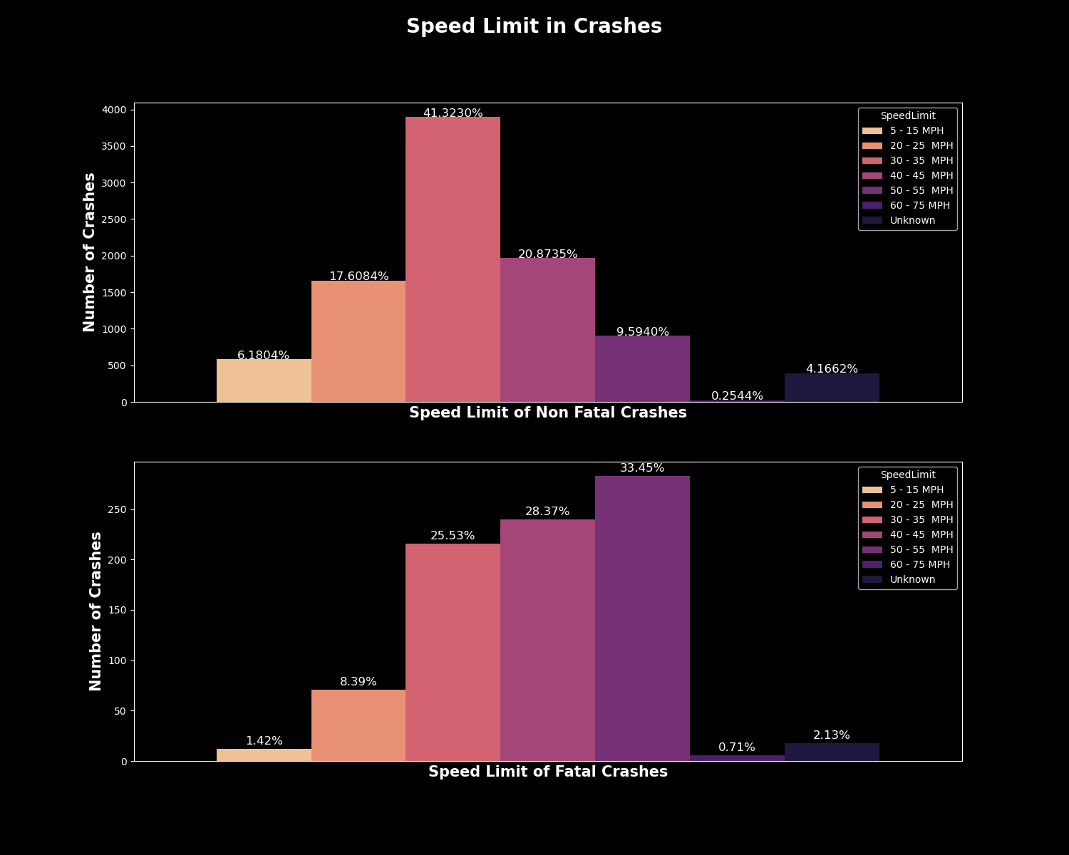
Speed Limit In Crashes
Speed Limit of 50-55 MPH was the biggest cause of Fatal crashes.
Would need more information on actual speed at the time of crash. Were there cases of over speeding?

Slide 15
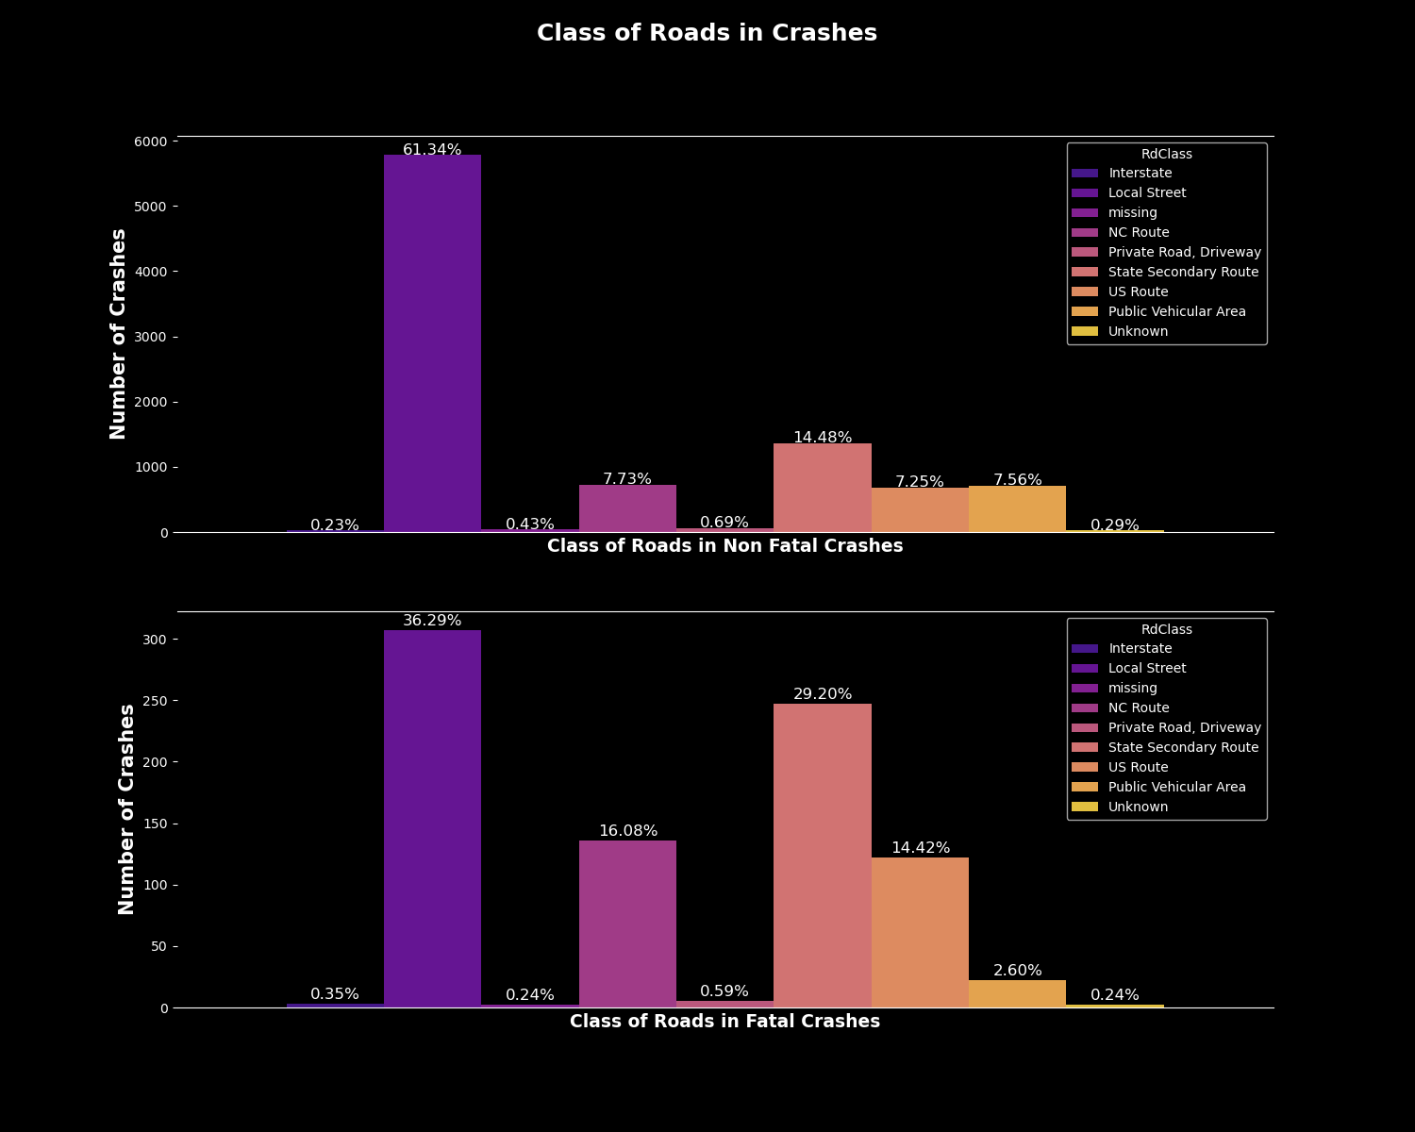
Class of Roads
Interstate roads are the biggest contributes to Fatal and non-Fatal crashes.
Further analysis on the possible reasons needs to be done.

Slide 16
Suggested Solutions
From the above attributes, more controlled traffic would be beneficial.
Improving road infrastructure: This can include adding better signage, road markings, and traffic lights
Increasing police presence
Technology solutions: Intelligent Transportation Systems (ITS)
Education and public awareness campaigns
Stricter enforcement of traffic laws
Improving road design:

Slide 17
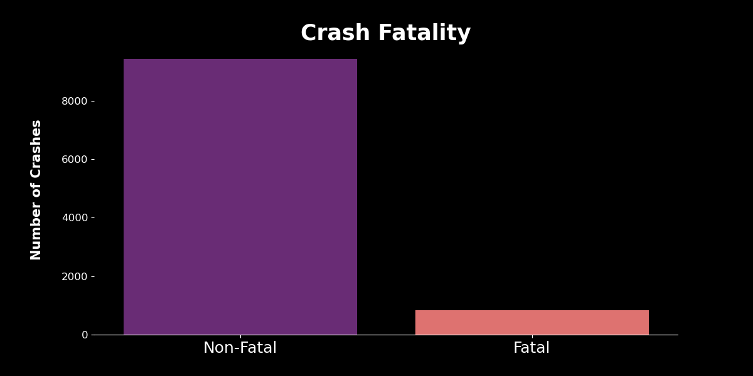
ML – Predicting Crash Fatality
The data in the dataset is imbalanced for the prediction (refer graph). We resampled the data as under sampling, where we reduced the number of majority (Non-Fatal) crashes.
The Machine Learning classifier algorithms that we used
Bagging Classifier (Sklearn)
Adaboost Classifier (sklearn)
Random Forrest Classifier (sklearn)

Slide 18
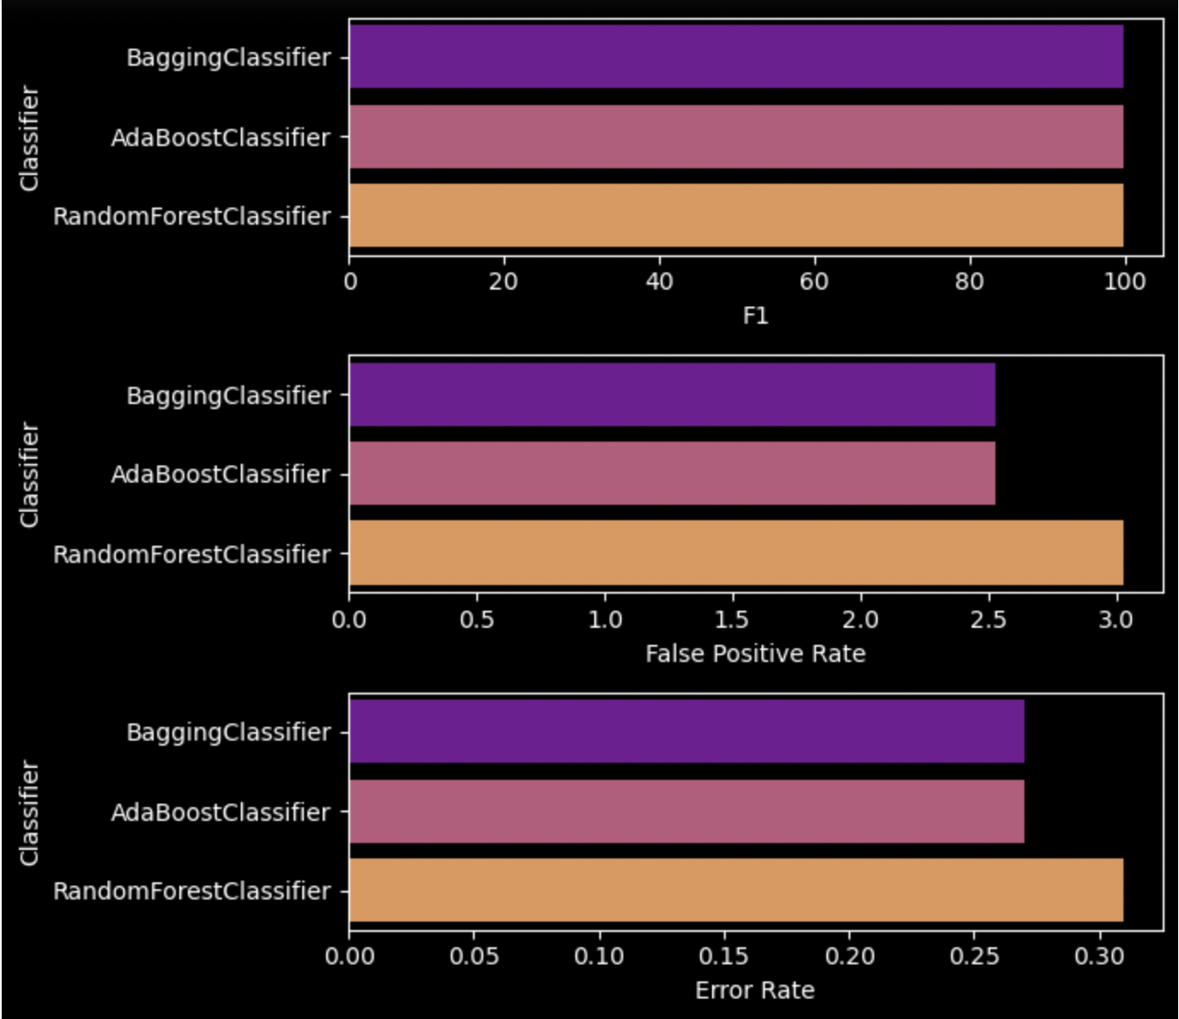
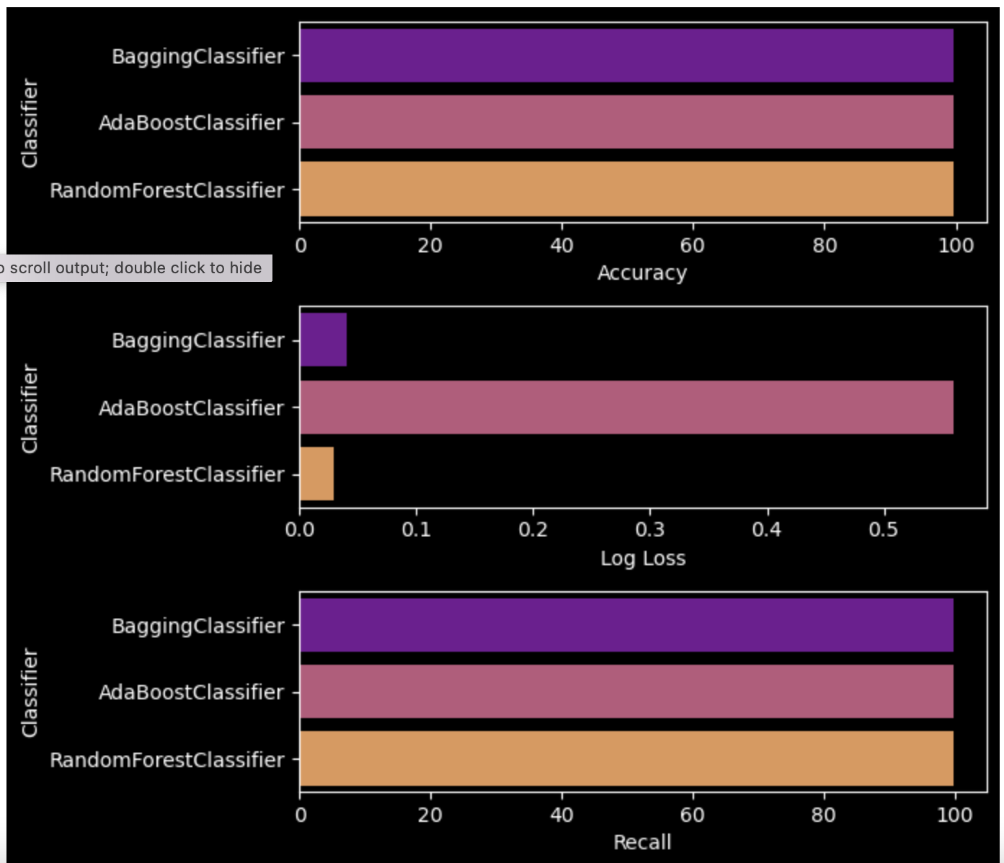
Based on the performance metrics, Random Forest Classifier is the best model in this case. Although all the models have high accuracy, Random Forest has the lowest log loss and error rate compared to Bagging Classifier and AdaBoost Classifier. Also, the recall and F1 score are similarly high for all three models.
Classifier | Accuracy | Log Loss | Recall | F1 | False Positive Rate | Error Rate
BaggingClassifier | 99.73 | 0.04 | 99.92 | 99.85 | 2.53 | 0.27
AdaBoostClassifier | 99.73 | 0.56 | 99.92 | 99.85 | 2.53 | 0.27
RandomForestClassifier | 99.69 | 0.03 | 99.92 | 99.83 | 3.03 | 0.31

Slide 19
Limitations
The possible limitations of the data set are:
The data was highly imbalanced, with most of the accidents being non-fatal. This affected the model performance, and under sampling was done to improve accuracy.
Some crucial factors related to accidents were not included, such as information on speeding by drivers, cell phone usage, time of arrival of emergency units, and information on passengers.
The low correlation values indicated weak relationships between the features and the target variable.
Some suggestions to overcome these limitations could be:
Collecting data on driver behaviour, such as speeding and cell phone usage, to improve the understanding of factors contributing to accidents.
Collecting information on the arrival time of emergency units and passengers to get a more comprehensive view of the situation.
To improve the model performance, consider alternative techniques to handle imbalanced data, such as oversampling or synthetic data generation.

